Slide 1
Analysis of Variance
Varsha S. Kulkarni

Slide 2

Multiple comparisons- from reference book
Once we have determined that there are differences among the means of the groups, that is, that the null hypothesis is rejected, we must follow through by determining the pattern of differences. Is one specific group responsible for the differences?
Several procedures have been developed to determine where the significant differences in the means lie after the ANOVA procedure has been performed. Scheffé test and the Tukey test are used.
Thus if there are 3 groups (or treatments) we have 3 pairwise comparisons of means : A-B, B-C, A-C

Slide 3
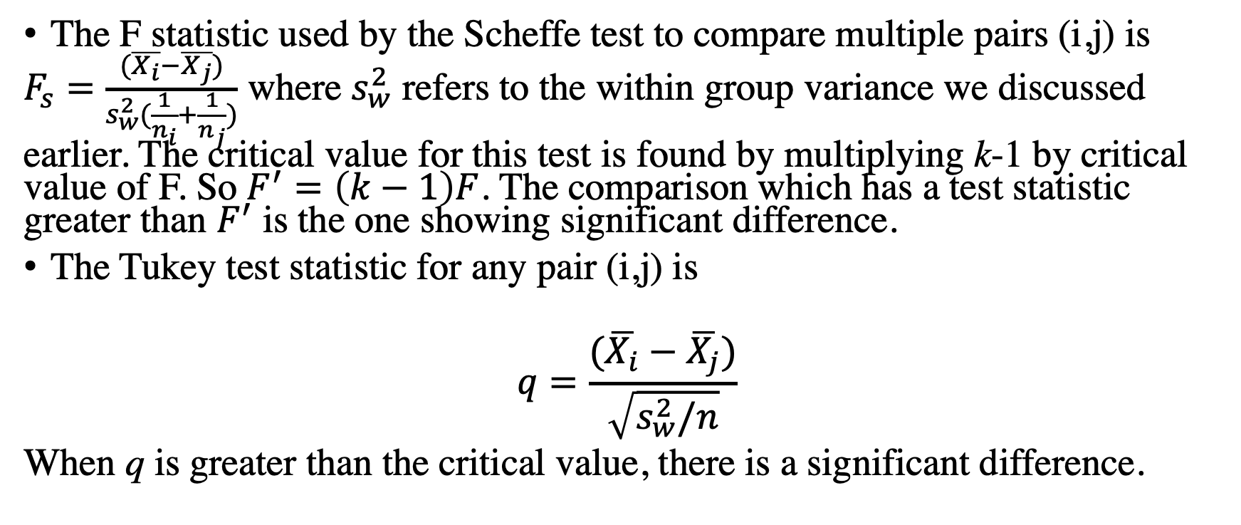
Scheffe test and Tukey test
The F statistic used by the Scheffe test to compare multiple pairs (i,j) is
$F_{s}=\frac{(\overline{X_{i}}−\overline{X_{j}})}{s_{w}^{2}(\frac{1}{n_{i}}+\frac{1}{n_{j}})}$ where $s_{w}^{2}$ refers to the within group variance we discussed earlier. The critical value for this test is found by multiplying k-1 by critical value of F. So $F^{′}=\left(k−1\right)F$. The comparison which has a test statistic greater than $F^{′}$ is the one showing significant difference.
The Tukey test statistic for any pair (i,j) is
$$q=\frac{(\overline{X_{i}}−\overline{X_{j}})}{\sqrt{s_{w}^{2}/n}}$$
When q is greater than the critical value, there is a significant difference.

Slide 4
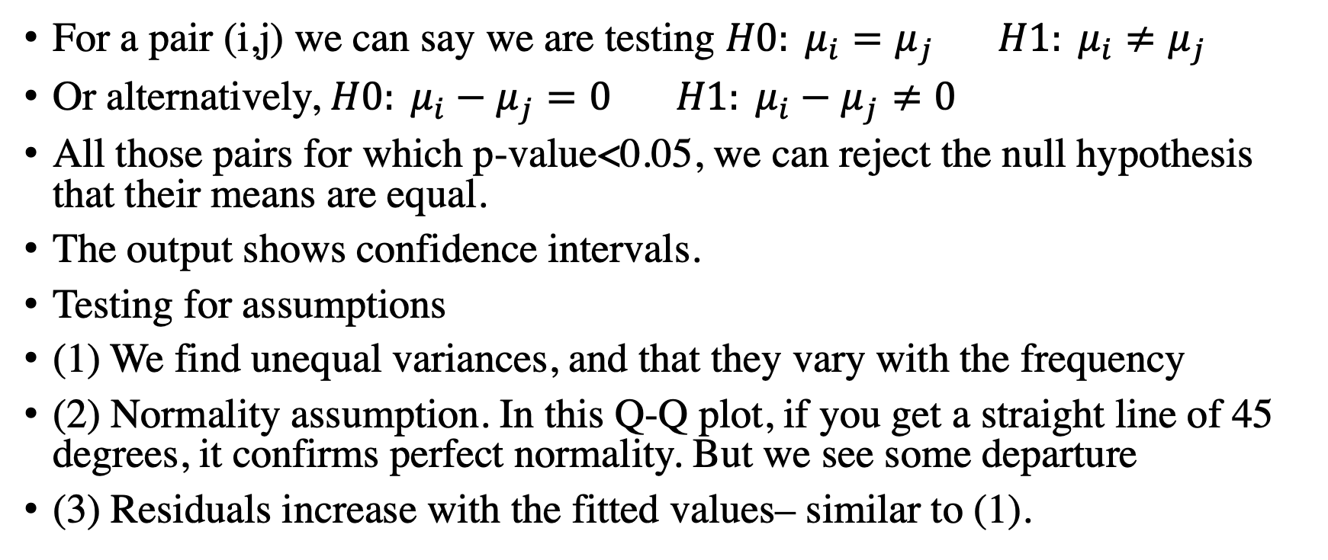
Implementing in R
For a pair (i,j) we can say we are testing $H0: μ_{i}=μ_{j} H1: μ_{i}≠μ_{j}$
Or alternatively, $H0: μ_{i}−μ_{j}=0 H1: μ_{i}−μ_{j}≠0$
All those pairs for which p-value<0.05, we can reject the null hypothesis that their means are equal.
The output shows confidence intervals.
Testing for assumptions
(1) We find unequal variances, and that they vary with the frequency
(2) Normality assumption. In this Q-Q plot, if you get a straight line of 45 degrees, it confirms perfect normality. But we see some departure
(3) Residuals increase with the fitted values– similar to (1).

Slide 5
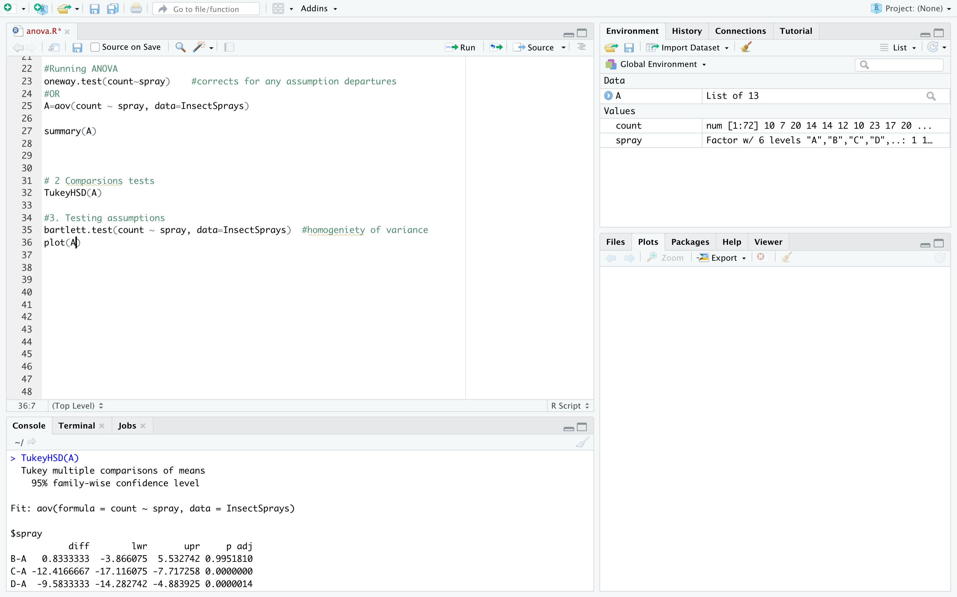

Slide 6
Data from excel into R
Suppose there is an excel data sheet in which there are different groups are listed as columns. (In the last lecture, you’d think of groups listed as columns of data in excel)
First you should convert the data into csv format. In the excel file--> save as-->
Import into R
In R refer to the name of this data instead of InsectSprays and repeat some of the previous lectures codes
The next 2 slides show the csv conversion and import into R

Slide 7
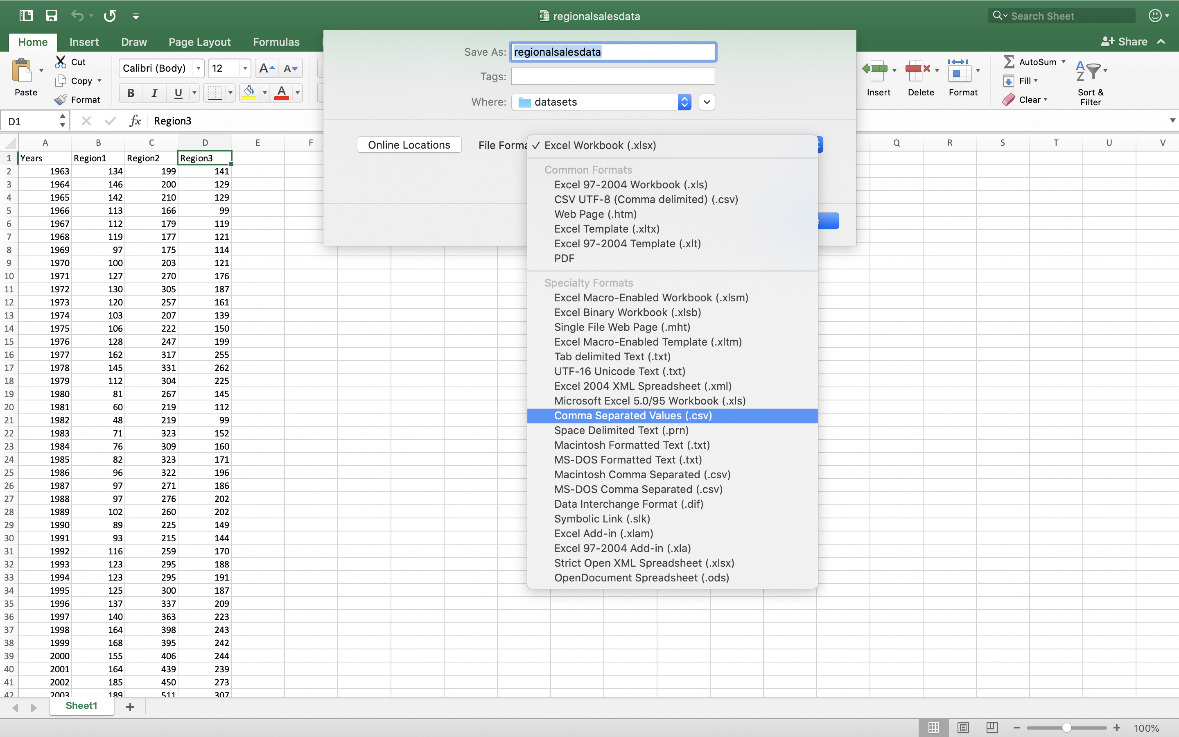

Slide 8
